Slide 1
Chapter 4
CONCEPTS OF LEARNING, CLASSIFICATION AND REGRESSION
Cios / Pedrycz / Swiniarski / Kurgan

Slide 2
Outline
Main Modes of Learning
Types of Classifiers
Approximation, Generalization and Memorization
© 2007 Cios / Pedrycz / Swiniarski / Kurgan

Slide 3
Main Modes of Learning
Unsupervised learning
Supervised learning
Reinforcement learning
Learning with knowledge hints and semi-supervised learning
© 2007 Cios / Pedrycz / Swiniarski / Kurgan

Slide 4
Unsupervised Learning
Unsupervised learning, e.g., clustering, is concerned with an automatic discovering of structure in data without any supervision.
Given N-dimensional dataset X = {x₁, x₂,…, x_{N}}, where each x_{k} is characterized by a set of attributes, determine structure, i.e., identify and describe groups (clusters) present within X.
© 2007 Cios / Pedrycz / Swiniarski / Kurgan

Slide 5
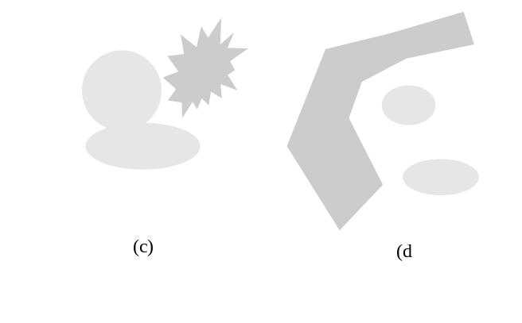
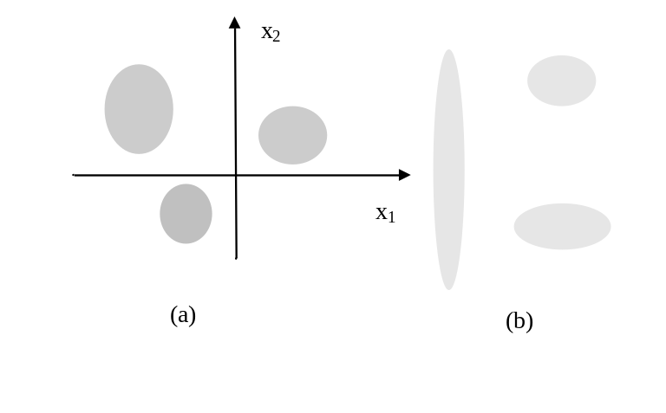
Examples of Clusters
Geometry of clusters (groups) and 4 ways of grouping patterns
© 2007 Cios / Pedrycz / Swiniarski / Kurgan

Slide 6
Defining Distance/Closeness of Data
Distance function d(x, y) plays a pivotal role when
grouping data
Conditions for a distance metric:
d (x,x) = 0
d(x, y ) = d(y,x) symmetry
d(x, z) + d(z, y) >= d(x,y) triangle inequality
© 2007 Cios / Pedrycz / Swiniarski / Kurgan

Slide 7
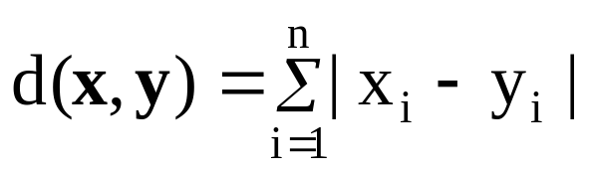
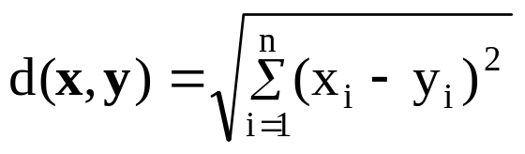

Examples of Distance Functions
Hamming distance
Euclidean distance
Tchebyschev distance
© 2007 Cios / Pedrycz / Swiniarski / Kurgan

Slide 8
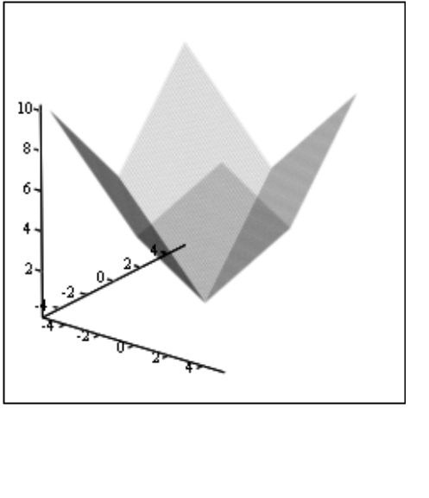
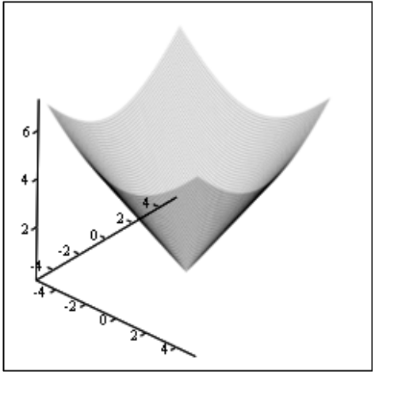
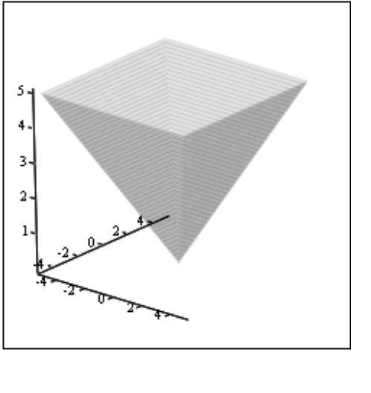
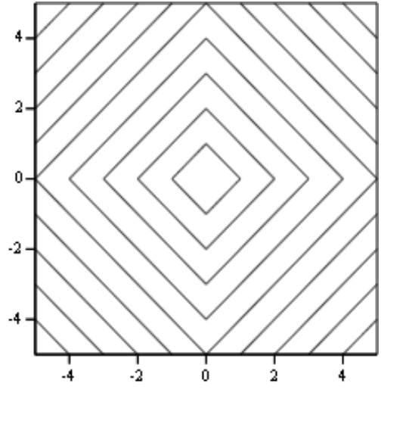
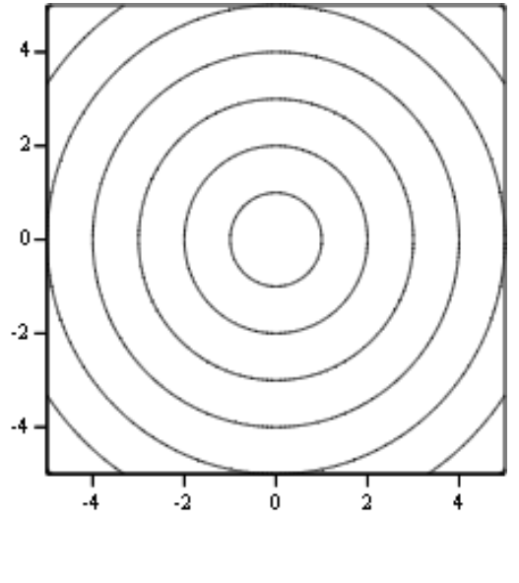
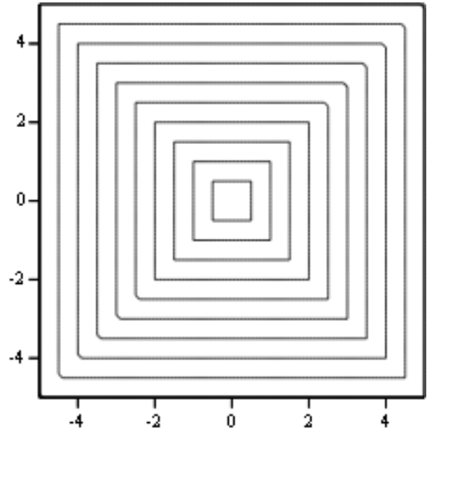
Hamming/Euclidean/ Tchebyschev Distances
© 2007 Cios / Pedrycz / Swiniarski / Kurgan

Slide 9
Supervised Learning
We are given a collection of data (patterns) in two forms:
discrete labels - in which case we have a classification problem
values of a continuous variable – in which case we have a regression or approximation problem
© 2007 Cios / Pedrycz / Swiniarski / Kurgan

Slide 10
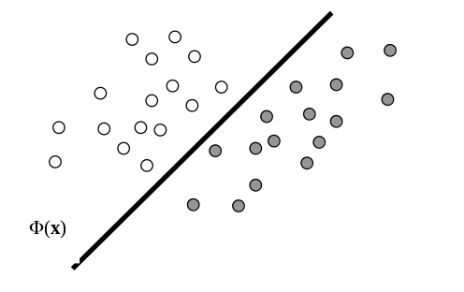
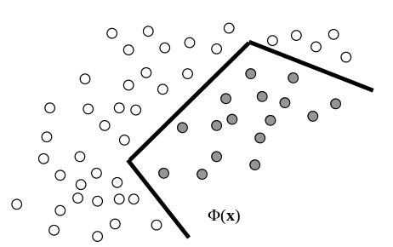
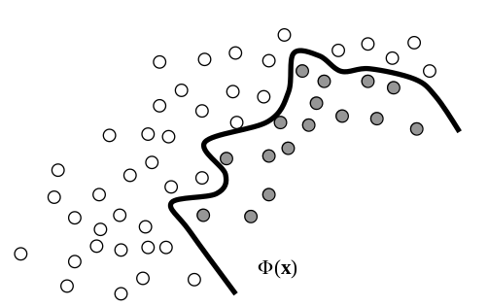
Examples of Classifiers
Linear classifier
Piece-wise linear classifier
Nonlinear classifier
© 2007 Cios / Pedrycz / Swiniarski / Kurgan

Slide 11
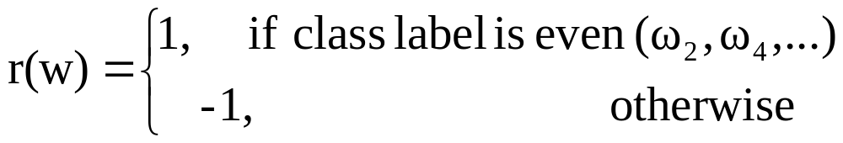
Reinforcement Learning
Reinforcement learning is guided by less detailed information (supervision mechanism) than in the case of supervised learning.
It comes in the form of reinforcement information (reinforcement signal).
For instance, given “c” classes, the reinforcement signal r(w) could be binary:
© 2007 Cios / Pedrycz / Swiniarski / Kurgan

Slide 12
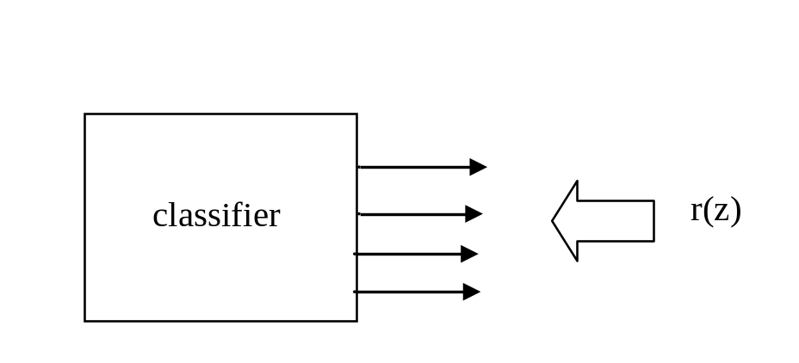
Reinforcement Learning
Reinforcement in classification- partial guidance through class combination
© 2007 Cios / Pedrycz / Swiniarski / Kurgan

Slide 13
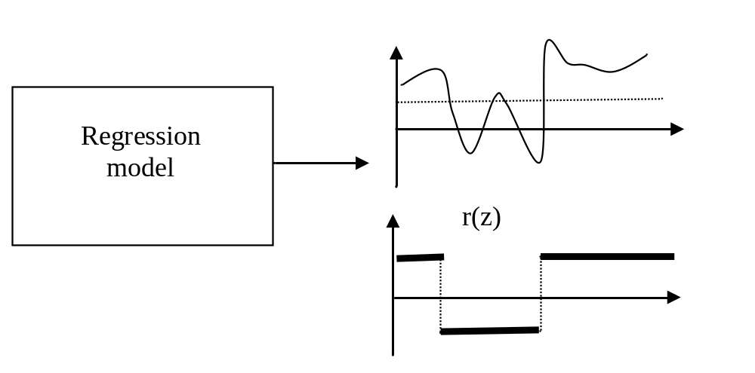
Reinforcement Learning
Reinforcement in regression- the thresholded version of target signal
© 2007 Cios / Pedrycz / Swiniarski / Kurgan

Slide 14
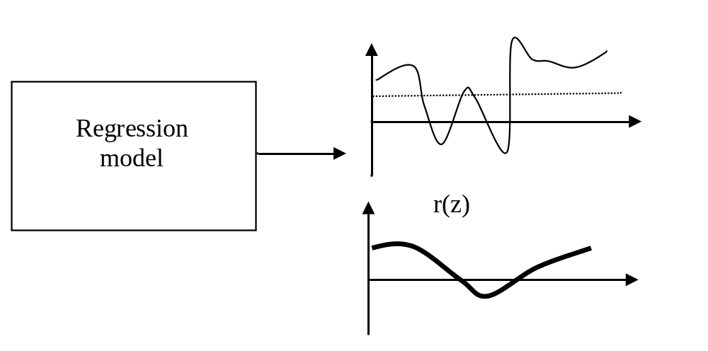
Reinforcement Learning
Reinforcement in regression- partial guidance through aggregate (average) of a signal
© 2007 Cios / Pedrycz / Swiniarski / Kurgan

Slide 15
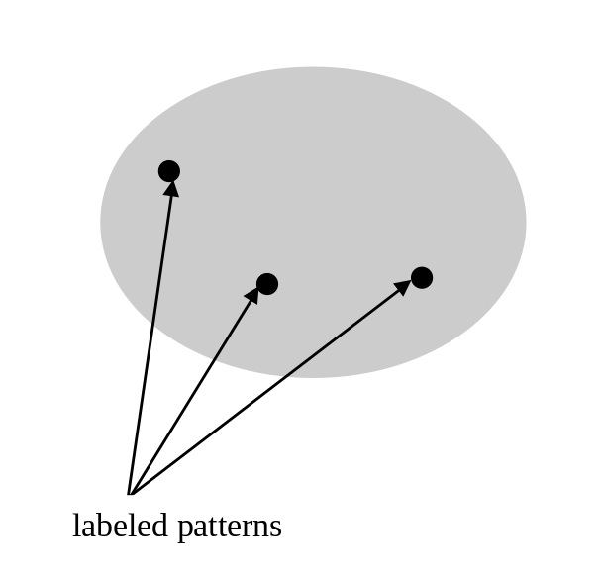
Semi-supervised Learning
Often, we possess some domain knowledge when clustering. It may be in the form of a small portion of data being labeled.
© 2007 Cios / Pedrycz / Swiniarski / Kurgan

Slide 16
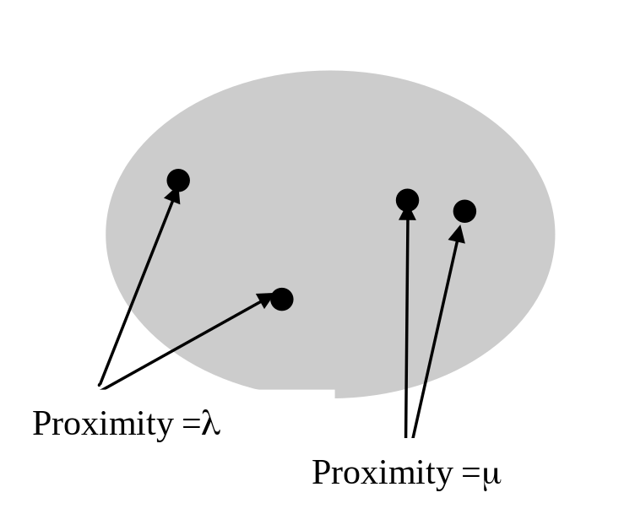
Learning with Proximity Hints
Instead of class labels, we may have pairs of data
for which proximity levels have been provided.
Advantages:
Number of classes is not required
Only some selected pairs of data are
considered
© 2007 Cios / Pedrycz / Swiniarski / Kurgan

Slide 17
Classification Problem
Classifiers are algorithms that discriminate between classes of patterns.
Depending upon the number of classes in the problem, we talk about two- and many-class classifiers.
The design of the classifier depends upon the character of data, number of classes, learning algorithm, and validation procedures.
Classifier can be regarded as the mapping (F) from feature space to class space
F: X → {ω₁, ω₂, …, ω_{c}}
© 2007 Cios / Pedrycz / Swiniarski / Kurgan

Slide 18
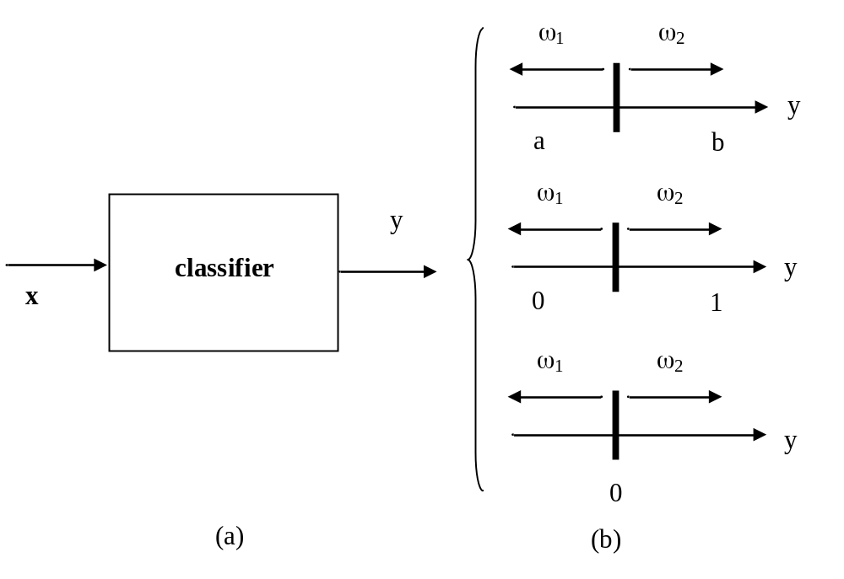
Two-Class Classifier and Output Coding
© 2007 Cios / Pedrycz / Swiniarski / Kurgan

Slide 19
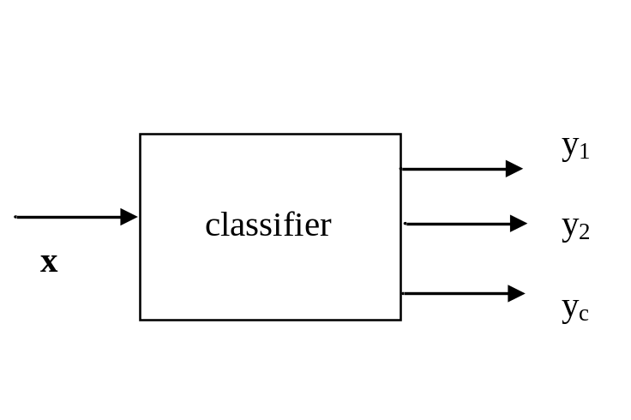
Multi Class Classifier
Maximum of class membership- select class (i0) for which
i0 = arg max {y1, y2,…, yc}
© 2007 Cios / Pedrycz / Swiniarski / Kurgan

Slide 20
Multi Class Dichotomic Classifier
We can split the c-class problem into a subset of two-class problems.
In each, we consider class, say ω₁, and the other class is formed
by all the patterns that do not belong to class ω₁.
Binary/dichotomic decision:
Φ₁(x) 0 if x belongs to ω₁
Φ₁(x) < 0 if x does not belong to ω₁
© 2007 Cios / Pedrycz / Swiniarski / Kurgan

Slide 21
Multi Class Dichotomic Classifier
Dichotomic decision:
Φ₁(x) 0 if x belongs to ω₁
Φ₁(x) < 0 if x does not belong to ω₁
Cases:
only one classifier generates a nonnegative value
several classifiers identify the pattern as belonging to a specific class.
conflict class assignment
no classifier issued a classification decision –
undefined class assignment.
© 2007 Cios / Pedrycz / Swiniarski / Kurgan

Slide 22
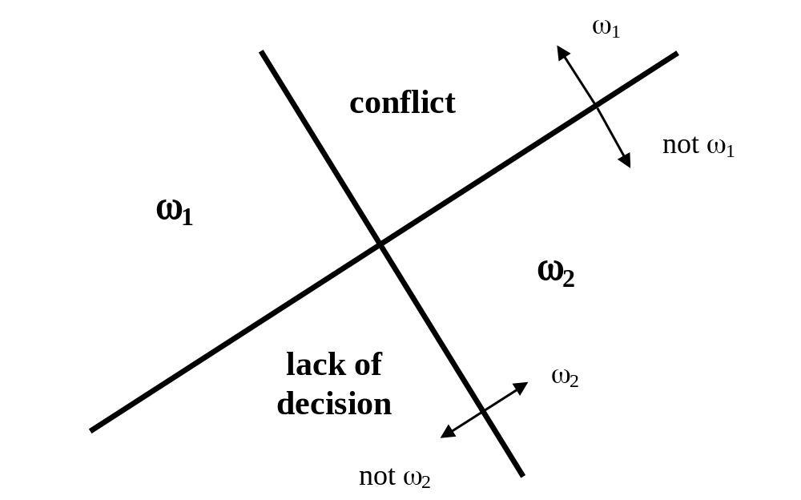
Multi Class Dichotomic Classifier
© 2007 Cios / Pedrycz / Swiniarski / Kurgan

Slide 23
Classification vs. Regression
In contrast to classification in regression we have:
continuous output variable and
the objective is to build a model (regressor) so that a certain approximation error is minimized
For a data set formed by pairs of input-output data
(x_{k}, y_{k}), k = 1, 2,…,N where y_{k} is in R
the regression model (regressor) has the form of some mapping F(x) such that for any x_{k} we obtain F(x_{k}) that is as close to y_{k} as possible.
© 2007 Cios / Pedrycz / Swiniarski / Kurgan

Slide 24
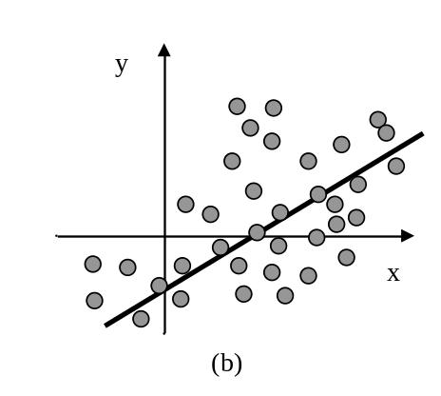
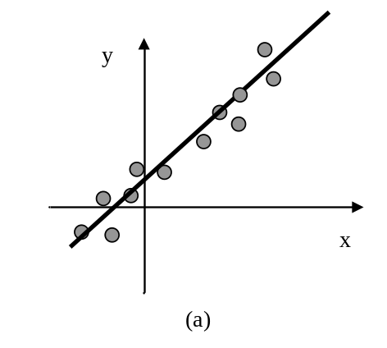
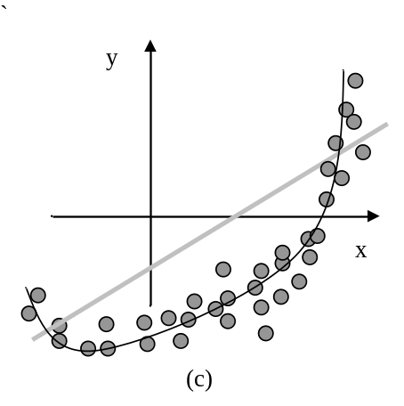
Examples of Regression Models
Linearly distributed data
High dispersion
Linearly distributed data
Low dispersion
Nonlinearly distributed data
Low dispersion
© 2007 Cios / Pedrycz / Swiniarski / Kurgan

Slide 25
Main Categories of Classifiers
Explicit and implicit characterization of classifiers:
Explicitly specified function - such as linear, polynomial, neural network, etc.
Implicit – no formula but rather a description, such as a decision tree, nearest neighbor classifier, etc.
© 2007 Cios / Pedrycz / Swiniarski / Kurgan

Slide 26
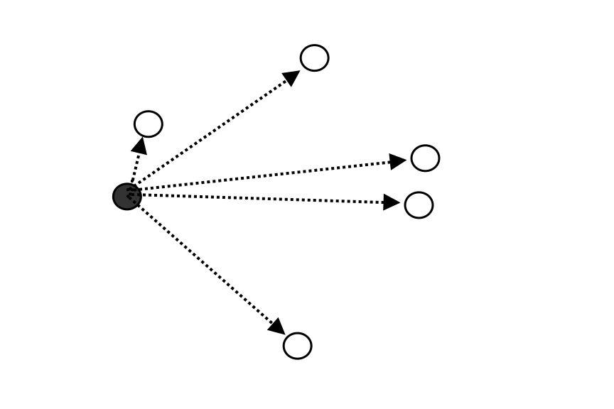
Nearest - Neighbor Classifier
Classify x considering class of the nearest neighbor
L = arg min_{k} ||x – x_{k}|| class of x is the same as the class to which x_{L} belongs to
© 2007 Cios / Pedrycz / Swiniarski / Kurgan

Slide 27
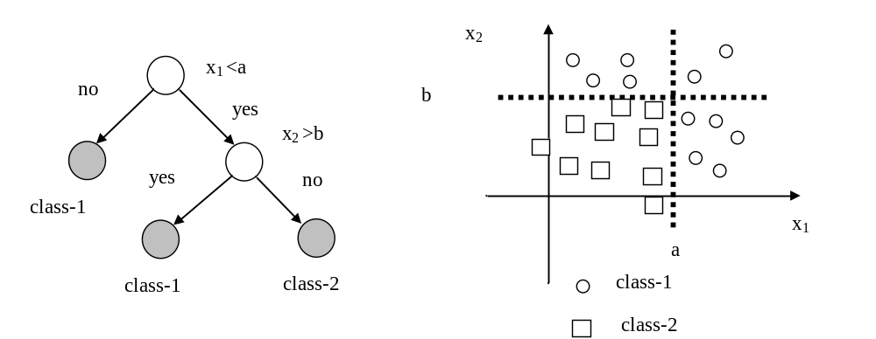
Decision Trees
Boundaries are always parallel to the coordinate axes.
© 2007 Cios / Pedrycz / Swiniarski / Kurgan

Slide 28
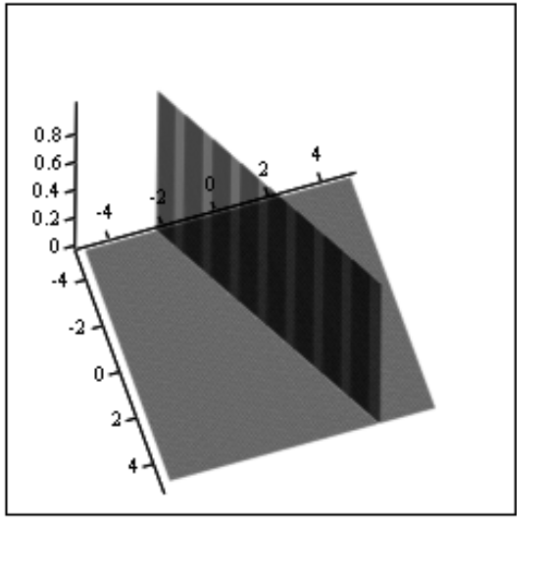
Linear Classifiers
Linear function of the features (variables)
Φ (x) = w₀ + w₁x₁ + w₂ x₂ + … +w_{n} x_{n}
Parameters of the classifier: w₀, w₁, ….
Geometry: line, plane, hyperplane
Linear separability of data
© 2007 Cios / Pedrycz / Swiniarski / Kurgan

Slide 29
Linear Classifiers
Linear classifiers can be described in a compact form by using vector notation:
Φ(x) = w^{T} x~
where w = [w₀ w₁ …w_{n}]^{T} and x~=[1 x₁ x₂ … x_{n}]
Note that x~ is defined in an extended/augmented input space that is
x~ =[1 x]^{T}
© 2007 Cios / Pedrycz / Swiniarski / Kurgan

Slide 30
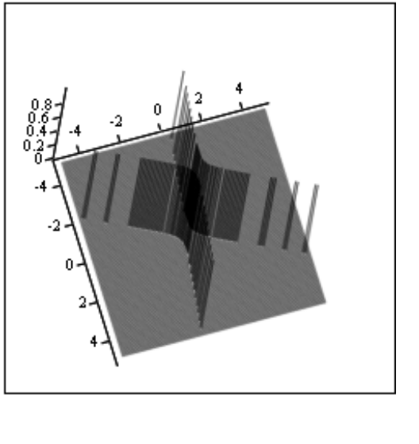
Nonlinear Classifiers
Polynomial classifiers
Φ(x) = w₀ + w₁x₁ + w₂ x₂ + … +w_{n} x_{n} +
+ w_{n+1}x₁² + w_{n+2}x₂²+ … + w_{2n} x_{n}²+
+ w_{2n+1}x₁x₂ +....
have nonlinear boundaries formed at the expense of increased dimensionality of the feature space.
© 2007 Cios / Pedrycz / Swiniarski / Kurgan

Slide 31
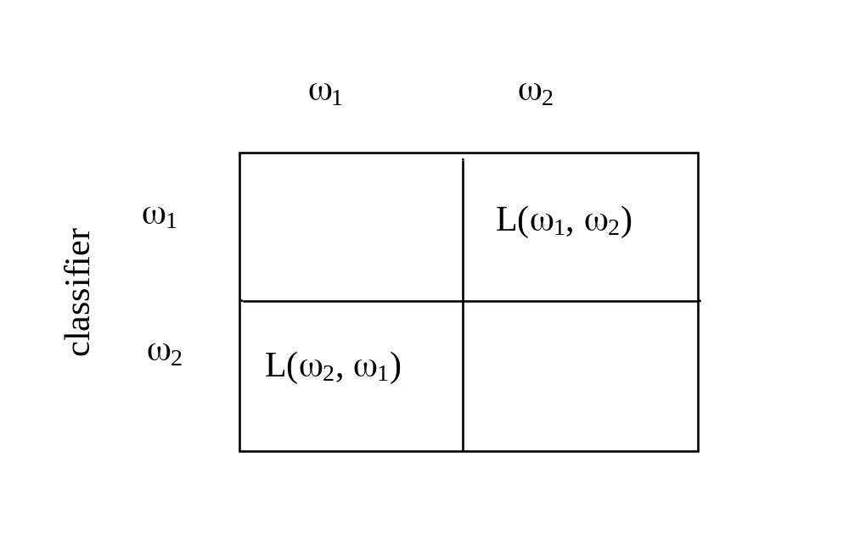
Performance Assessment
Loss function: L(ω₁, ω₂) and L(ω₂, ω₁)
Correct classification
losses
© 2007 Cios / Pedrycz / Swiniarski / Kurgan

Slide 32
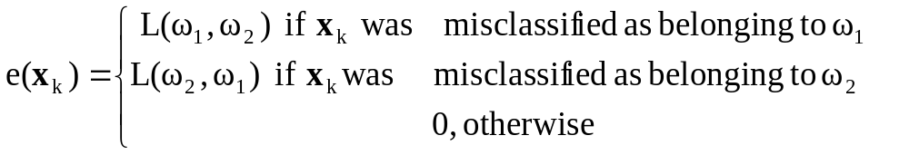
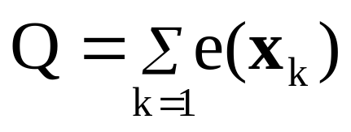
Performance Assessment
A performance index is used to measure the quality of the classifier and can be expressed for the k-th data point as:
We sum up the above expressions over all data to express the total cumulative error
© 2007 Cios / Pedrycz / Swiniarski / Kurgan

Slide 33
Generalization Aspects of Classification/Regression Models
Performance is assessed with regard to unseen data. Typically,
the available data are split into tow or three disjoint subsets
Training
Validation
Testing
Training set - used to complete training (learning) of the classifier.
All optimization activities are guided by the performance index
and its changes are reported for the training data.
© 2007 Cios / Pedrycz / Swiniarski / Kurgan

Slide 34
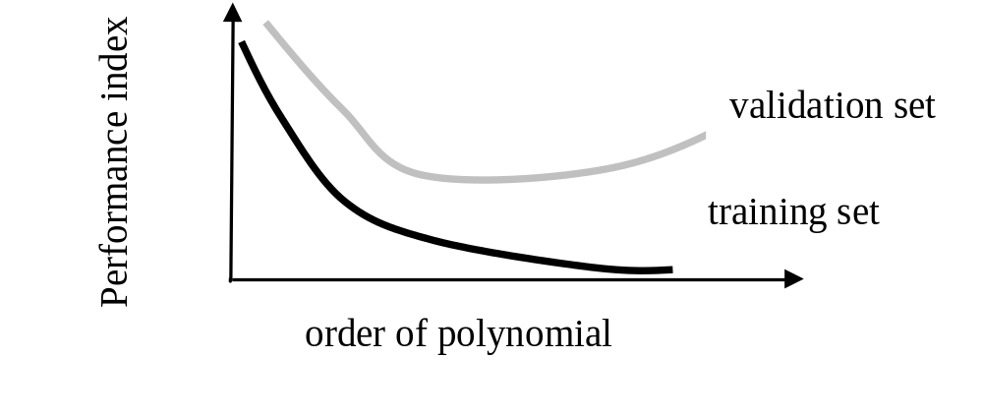
Overtraining and Validation Sets
Consider polynomial classifiers
Validation set is essential in selecting a structure of classifiers
By using validation set, we can determine an optimal order
of the polynomial
© 2007 Cios / Pedrycz / Swiniarski / Kurgan

Slide 35
Approximation, Generalization and Memorization
Approximation – generalization dilemma: excellent performance on the training set but unacceptable performance on the testing set.
Memorization effect: data becomes memorized
(including those data points that are noisy)
and thus classifier exhibits poor generalization abilities.
© 2007 Cios / Pedrycz / Swiniarski / Kurgan

Slide 36
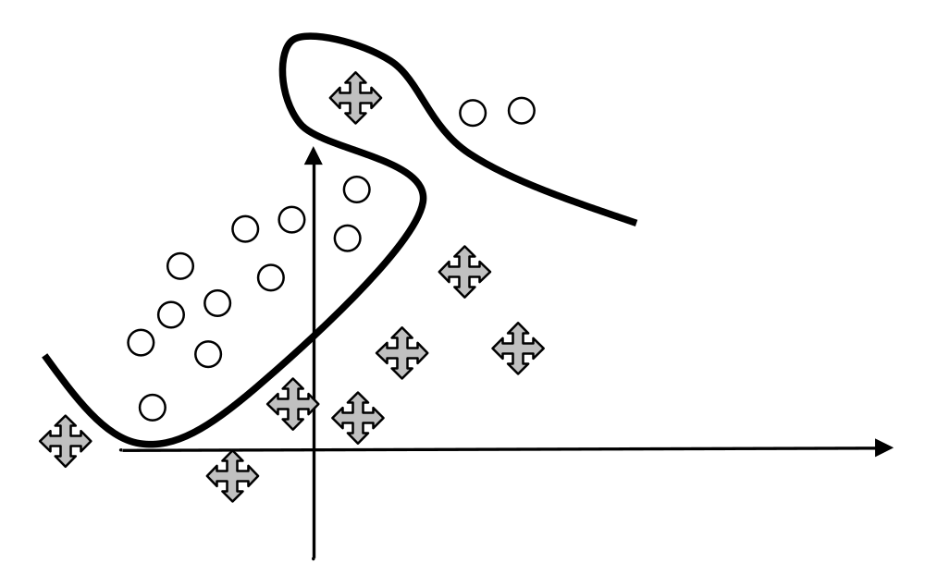
Approximation, Generalization and Memorization
Nonlinear classifier produced zero classification error but with
poor generalization ability.
© 2007 Cios / Pedrycz / Swiniarski / Kurgan

Slide 37
References
Bishop, C.M. 1995. Neural Networks for Pattern Recognition, Oxford University Press
Duda, R.O, Hart, PE and Stork DG. 2001 Pattern Classification, 2nd edition, J. Wiley
Kaufmann, L. and Rousseeuw, P.J. 1990. Finding Groups in Data: An Introduction to Cluster Analysis, Wiley
Soderstrom, T. and Stoica, P. 1986. System Identification, Wiley
Webb, A. 2002. Statistical Pattern Recognition, 2nd edition, Wiley
© 2007 Cios / Pedrycz / Swiniarski / Kurgan

